Slide 1
Forecasting Intermittent Demand
Traditional smoothing approaches versus the Croston method

Slide 2

About Me
Masters in Business Analytics from National University of Singapore.
5+ Years experience in Tech Consulting and Insurance Industry.
Have worked on projects for Manufacturing, Insurance and Retail Clients.
Helping enterprise transformation through RoboticDataScience*.
Prateek Nagaria
Data Scientist
The Data Team, Singapore.
Email: prateek.nagaria@thedatateam.net
*Visit at Data Team’s Booth (No. 6) to know more about Robotic Data Science.

Slide 3
What will we learn today ☺
What is Intermittent demand?
Why is it difficult to forecast intermittent demand using Traditional Methods?
Methods for Intermittent demand forecasting.
How to apply and interpret Croston method.
Comparative analysis on Real-World SKUs data in R.
What is the Impact of better forecast on your business?

Slide 4
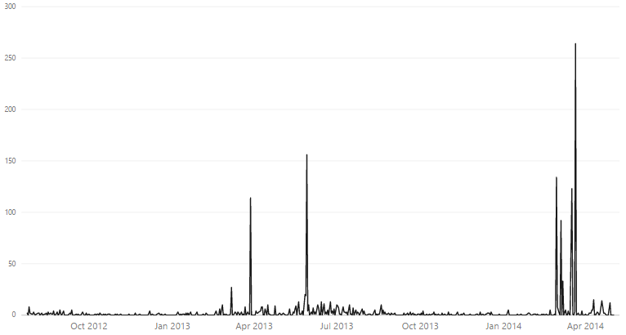
What is Intermittent Demand?
When a product experiences several periods of zero demand.
Often demand is small, and sometimes highly variable in size.
Very common in industries such as aviation, automotive, defence, manufacturing and retail.
Also seen for products nearing end of their life cycle.
288 Days of zero demand over 1.8 years
Highly Irregular

Slide 5
Difficulties with Traditional Forecasting For Intermittent data
Simple Moving Average:
Forecast based on mean computed for most recent observations.
Equal weights is assigned to each past observation.
Exponential Smoothing:
Recent observations have higher influence on the forecast.
Exponentially decreasing weights are assigned to observations.
ARIMA:
Makes prediction based on previous p points (auto-regressive) and on the previous q residuals (moving-average).
Inappropriate for Intermittent data as it allows values that aren't non-negative integers.
Difficulties with Intermittent Data
There is an upward bias in the forecast, directly after a non-zero demand.
Leads to a poor forecast for Intermittent data.

Slide 6
Methods – Forecasting Intermittent Demand
Methods
Ad-hoc methods
Model-based methods
Alternative methods
Croston method
Adjusted Croston methods
Discrete ARMA
INARMA
Bootstrapping
Temporal Aggregation
Most Widely Used

Slide 7
Croston Method
Provides better results when the demand does not exhibit a strict seasonal pattern and have multiple periods of zero demand.
Separates intermittent data into two components:
Non-zero demand time series
Inter-demand interval time series
Both series are forecasted independently using single exponential smoothing (SES)
Demand Size
Inter-arrival time
Dividing resulting estimates produces the final forecast
Average Demand per time period
Note: This is not a point forecast

Slide 8
Interpreting Croston Results
Sample outputs from Croston
Demand | Interval
3.97 | 1.41
In the next 1.4 days we are likely to get demand for 3.9 units of the forecasted product.
Represents Demand Size
Represents Inter-arrival time
Assuming we are forecasting for next 5 days, below will be the output for average demand for these 5 days.
2.81 | 2.81 | 2.81 | 2.81 | 2.81
3.97 / 1.41
For next 5 days, we are likely to get demand for 14 (2.81 * 5) products

Slide 9
Croston Variations
Several variations to the original Croston method exists which can be evaluated for a given intermittent data.
Syntetos-Boylan approximation (SBA) [1]
Shale-Boylan-Johnston (SBJ) [2]
Teunter, Syntetos and Babai (TSB) [3]
Claims to remove biases associated with original Croston method.
Useful for products for which are nearing end of their life cycle.

Slide 10
Comparative Analysis on Real World Data

Slide 11
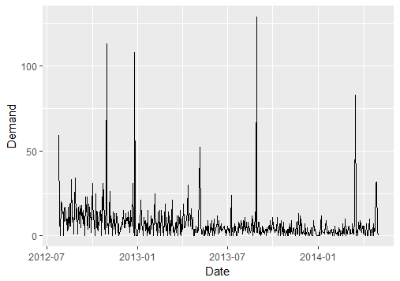
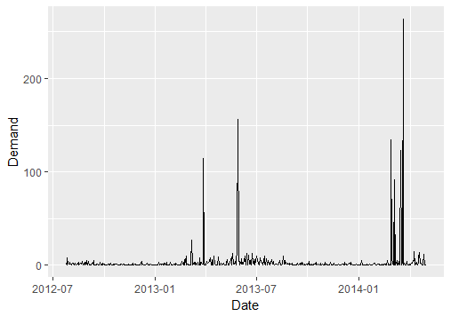
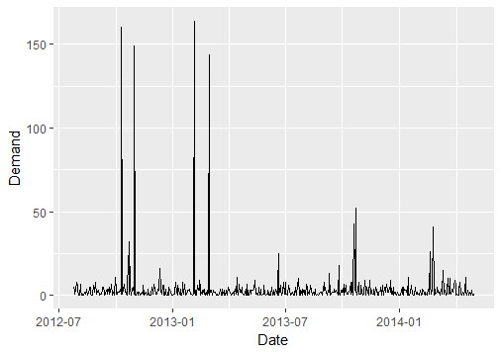
About the Data
Approximately 1.8 Years of Demand Data for 3 SKU’s of a Retail.
Name | No. of Records* | No. of Zeros | Proportion of Zeros
sku1 | 555 | 75 | 14%
sku2 | 555 | 288 | 52%
sku3 | 555 | 135 | 24%
*If the demand was consistently 0 for either Saturday or Sunday, all the Saturday’s and Sundays were removed from the respective SKU’s data.
sku1
sku2
sku3

Slide 12
Evaluating Croston Method
Rolling forecast have been made (considering horizon of 5 days) for the last 10 days of the time series.
MAPE of the forecasted values computed by comparing with the actuals.
For comparative analysis similar forecast has also been performed using below methods:
Simple Moving Average (SMA)
Exponential Smoothing
ARIMA
 | Day1 | Day2 | Day3 | Day4 | Day5 | Total Demand
Actual | 4 | 4 | 5 | 3 | 31 | 43
Forecasted Avg. Demand | 6.7 | 6.7 | 6.7 | 6.7 | 6.7 | 34
MAPE
The total demand of window is used to compute MAPE
Abs(34-43) * 100
43

Slide 13
Rolling Forecast Example
Day1 | Day2 | Day3 | Day4 | Day5 | Day6 | Day7 | Day8 | Day9 | Day10
0 | 9 | 8 | 2 | 2 | 0 | 1 | 3 | 4 | 1
Window 1
Window 2
Window 3
Window 4
Window 5
Window 6

Slide 14
How did Croston Performed?
For SKU1 (Low intermittency)
Method | MAPE Window1 | MAPE Window2 | MAPE Window3 | MAPE Window4 | MAPE Window5 | MAPE Window6 | Mean MAPE
SMA | 21.5 | 45.4 | 68.9 | 67.9 | 66.6 | 65.0 | 55.9
Exponential Smoothing | 16.4 | 55.8 | 71.9 | 71.8 | 70.7 | 60.8 | 57.9
ARIMA | 2.0 | 54.5 | 73.1 | 72.9 | 71.7 | 69.6 | 57.3
Croston | 69.0 | 21.7 | 55.1 | 56.0 | 52.8 | 52.8 | 51.2
Atleast 8% better accuracy than other methods
Croston performs slightly better than other methods for data with Low intermittent demand.

Slide 15
How did Croston Performed?
For SKU2 (High intermittency)
Method | MAPE Window1 | MAPE Window2 | MAPE Window3 | MAPE Window4 | MAPE Window5 | MAPE Window6 | Mean MAPE
SMA | 523.1 | 47.2 | 60.1 | 55.8 | 48.9 | 34.7 | 128.3
Exponential Smoothing | 1455.8 | 249.8 | 268.0 | 256.2 | 244.4 | 233.8 | 451.3
ARIMA | 1152.1 | 185.2 | 191.1 | 237.4 | 169.2 | 156.9 | 348.6
Croston | 233.3 | 22.9 | 16.7 | 16.7 | 38.9 | 57.0 | 64.3
At least twice as better accuracy than other methods
Croston performs significantly better than other methods for data with High intermittent demand.

Slide 16
How did Croston Performed?
For SKU3 (Mild intermittency)
Method | MAPE Window1 | MAPE Window2 | MAPE Window3 | MAPE Window4 | MAPE Window5 | MAPE Window6 | Mean MAPE
SMA | 191.9 | 149.5 | 148.7 | 248.3 | 188.8 | 477.6 | 234.1
Exponential Smoothing | 229.6 | 182.6 | 181.4 | 294.1 | 227.6 | 554.8 | 278.4
ARIMA | 229.7 | 182.2 | 181.7 | 294.0 | 227.7 | 555.2 | 278.4
Croston | 66.7 | 42.9 | 42.9 | 100.0 | 66.7 | 233.3 | 92.1
At least twice as better accuracy than other methods
Croston performs significantly better than other methods for data with Mild intermittent demand.

Slide 17
Impact of Demand Forecasting
Optimized Inventory:
Maintaining lower End of day (EOD) inventory on Average.
Having a dynamic Re-order point (ROP)*, based on forecasted lead time demand.
Reduced Demand Uncertainties:
Lesser number of stock-out days.
Better understanding of customer needs.
Cost Savings:
More profitable linking of pricing, promotions & other sales incentives.
More efficient & predictable use of plant capacity, equipment and labor.
*ROP= Safety Stock + Lead Time Demand

Slide 18
Demo on R

Slide 19
Applying Croston Method
Package ‘tsintermittent’ in R.
Function Name: crost
Variants Available (type):
"croston" - Croston's method
"sba" - Syntetos-Boylan approximation
"sbj" - Shale-Boylan-Johnston
Cost Function for Optimization:
"mar" - Mean Absolute Rate
"msr" - Mean Squared Rate
"mae" - Mean Absolute Error
"mse" - Mean Squared Error

Slide 20
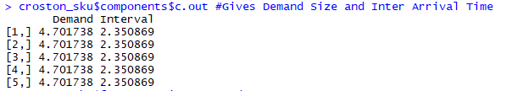
Sample Croston Output from SKU3
Training the Model, with Forecast horizon of 5 days
Output for Demand Size and Inter-Arrival Time
In the next 2.35 days we are likely to get demand for 4.7 units of the forecasted product.
Output for the Demand Rate of the Forecasted window
For next 5 days, we are likely to get demand for 10 (2 * 5) products

Slide 21
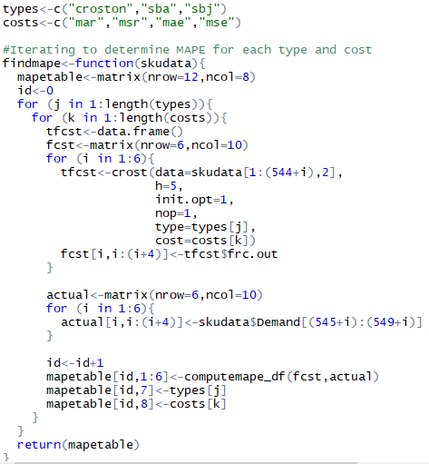
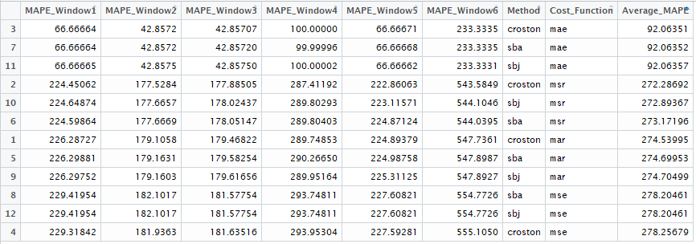
Rolling Forecast Finding Optimal Parameters
Method ‘croston’ and Cost Function ‘mae’ are optimal parameters based on least MAPE.

Slide 22
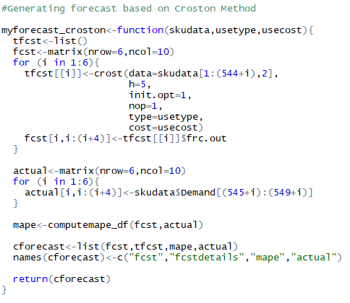
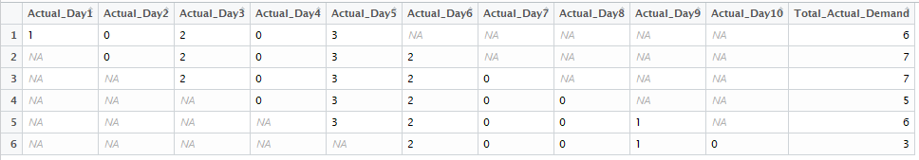
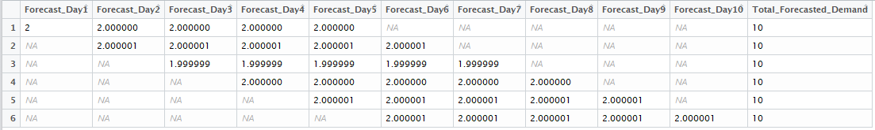
Rolling Forecast Applying Croston Method
Actual Demand
Forecasted Demand Rate
MAPE For Forecasted Values

Slide 23
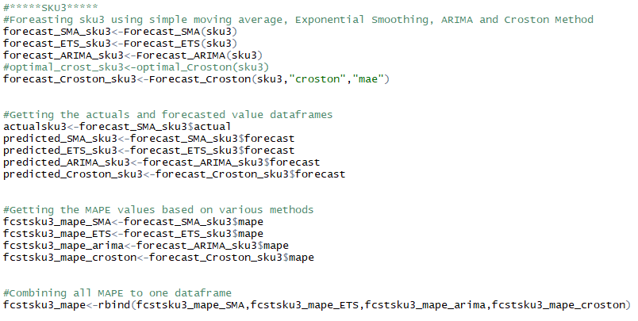
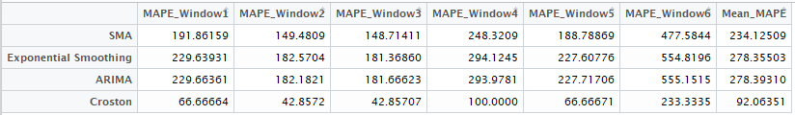
Rolling Forecast Comparing Various Methods
Forecast Accuracy of Various Methods

Slide 24
Try it Yourself
Code snippet and sample data available at below link:
https://bitbucket.org/prateeknagariaDT/strata_demo/

Slide 25
Key Takeaways
Methods such as Croston may provide a better forecast accuracy than traditional methods for intermittent demand forecasting.
Several variants of Croston and Cost Functions may be evaluated for setting up optimal model parameters.
Although Croston may not provide a point forecast, its still of great value for inventory optimization.
Significant cost savings can be achieved if appropriate forecasting method is used for a given data.

Slide 26
References
Syntetos,A.A.,Boylan,J.E.,2001. On the bias of intermittent demand estimates .Int. J. Prod.Econ.71(May(1–3)), 457–466.
Shale, E.A.,Boylan,J.E.,Johnston,F.R.,2006.Forecasting for intermittent demand: the estimation of an unbiased average.J.Oper.Res.Soc.57,588–592.
Teunter,R.H.,Syntetos,A.A.,Babai,M.Z.,2011.Intermittentdemand: linking forecasting to inventory obsolescence. Eur.J.Oper.Res.214(3),606–615.
Methods for Intermittent Demand Forecasting - Daniel Waller
On Intermittent Demand Model Optimisation and Selection - N. Kourentzes, 2014, International Journal of Production Economics, 156: 180-190.
Package ‘tsintermittent’ in R.

Slide 27

Thank You
Prateek Nagaria
prateek.nagaria@thedatateam.net
https://www.linkedin.com/in/prateeknagaria/

Slide 28
Croston Variations Detail - Additional
Syntetos and Boylan reported an error in Croston's mathematical derivation of expected demand, and proposed an approximate correction now usually referred to as the Syntetos-Boylan approximation.
Shale, Boylan, and Johnston derived the expected bias in Croston's method and proposed an 'exact' correction factor.
Boylan and Syntetos, Teunter proposed method to deal with obsolescence issues. To address this, they proposed a new method that estimates the probability of non-zero demand (rather than interval size), and in that the estimates are updated every period, rather than just when demand occurs. In this method, different smoothing parameters are used here for smoothing demand size and demand probability.

Slide 29
Croston Method Issues - Additional
Bias:
Syntetos and Boylan showed that demand predicted by croston is Biased and the croston forecast should be multiplied by factor of (1-α/2) to make it unbiased.
Dealing with Product obsolescence:
Original Croston Method assumed that demand size and demand interval are independent of each other.
Teunter, Syntetos and Babai (TSB) method overcomes this limitation by predicting the probability of non-zero demand (rather than interval size), and in that the estimates are updated every period, rather than just when demand occurs.

Slide 30
Model Based Methods - Additional
DARMA models:
Discrete ARMA (DARMA) models take values on a discrete set, according to the results of some random variables.
INARMA models:
Integer-valued ARMA (INARMA) models take previous autoregressive and moving average terms, `thin' them, and add some random non-negative integer.

Slide 31
Alternative Methods - Additional
Bootstrapping:
Bootstrapping is a statistical technique involving random sampling with replacement.
Method uses bootstrapping on previous observations of non-zero demand to forecast demand over some lead time.
Temporal aggregation:
Basic idea of temporal aggregation is to combine time periods into blocks.
This has the advantage that it could remove zeros in the series, but also the disadvantage that the number of historical observations is greatly reduced.

